Slide 1
Text Mining
Vectorization
From Text to Vector

Slide 2
Text Representation/Vectorization
Convert text to numbers
Computers can do only ONE thing, that is, COUNTING!

Slide 3
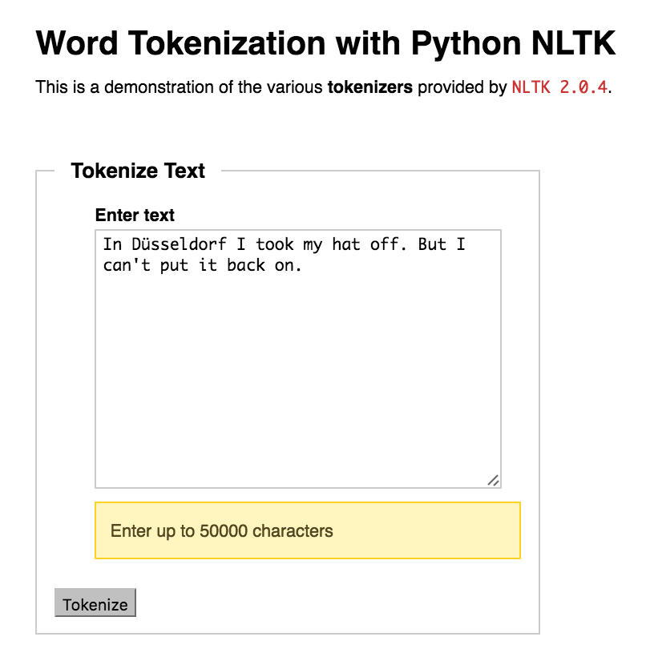
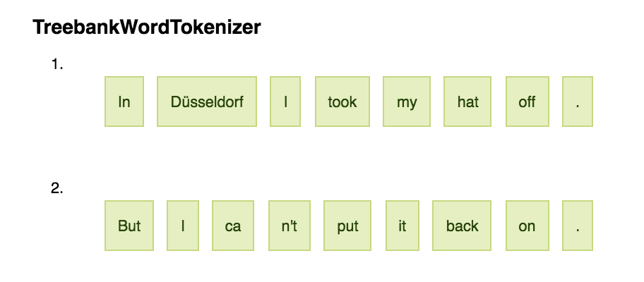
Tokenization
A tokenizer has a set of rules about grouping characters into tokens

Slide 4


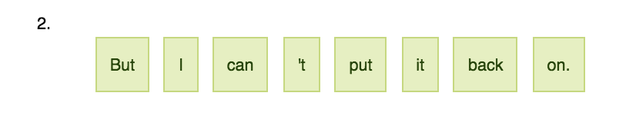
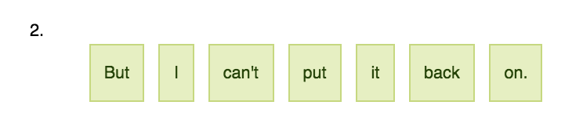
Tokenization rules

Slide 5
Tokenization is not easy
Tokenizing urls
Choosespain.com

Slide 6
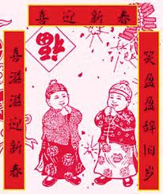
Tokenization is not easy
Tokenize text strings with no whitespace
Chinese (New Year couplets):
养猪大如山老鼠头头死
Raise|pigs|big|as|mountain|rats|all|die
养|猪|大|如|山|老鼠|头头|死
Raise|pigs|big|as|mountain rats, all|die
养|猪|大|如|山老鼠| 头头|死

Slide 7
Tokenization is not easy
Lowercase vs. uppercase
Words with inflected forms
“dishwasher” vs. “dishwashers”
Words with multiple senses
“There is a money bank near the river bank.”

Slide 8
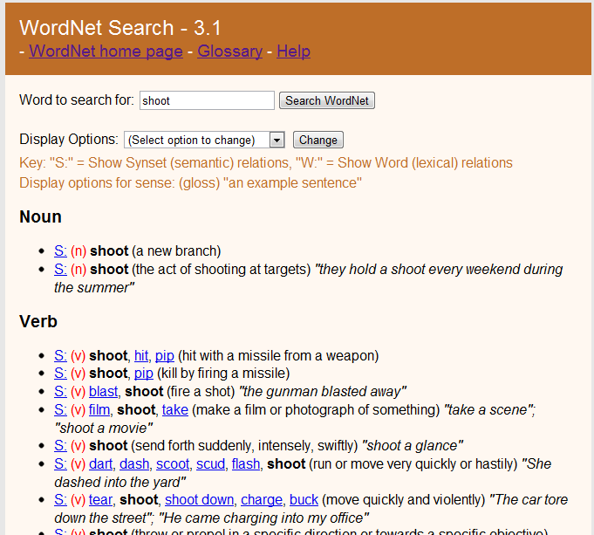
WordNet
http://wordnetweb.princeton.edu/perl/webwn

Slide 9
Word Sense Disambiguation (WSD)
WSD techniques use word context to decide the word sense
Could introduce more errors to next steps
So far does not help search engines significantly
Not widely used in text mining
Text mining tends to use shallow features to process large amount of text data

Slide 10
Exercise: NLTK tokenizer demo
Use the NLTK tokenizer demo to tokenize the following paragraph. Explain which tokenizer provides the best result, and why
http://text-processing.com/demo/tokenize/
“Sheri Ackert worried she might have a new tumor. Steve Hammons stopped taking his blood-thinning medication. Kimberly Toy emptied the pasta and sweets from her cupboards and said: “I can’t believe this happened.”

Slide 11
How to Count Tokens
Convert documents into word vectors
Bag of Words (BOW)
Boolean
Term frequency
Normalized term frequency
Tf*idf

Slide 12
Vectorization
Step 1: create a dictionary of unique words
1 “vector” 2 “number” 3 “text” …
Step 2: represent every document as a word vector: each word is an attribute/feature
 | “vector” | “number” | “text” | …
Doc1 | 1 | 0 | 0
Doc2 | 1 | 1 | 1
doc3 | 1 | 0 | 1

Slide 13
Values of word features
Boolean value: word presence or absence
 | “vector” | “number” | “text” | …
Doc1 | 1 | 0 | 0
Doc2 | 1 | 1 | 1
doc3 | 1 | 0 | 1

Slide 14
Values of word features
Word frequency: the number of word occurrences
 | “vector” | “number” | “text” | …
Doc1 | 5 | 0 | 0
Doc2 | 1 | 3 | 6
doc3 | 2 | 0 | 8

Slide 15
Values of word features
Normalized word frequency: word frequency normalized by the document length
 | “vector” | “number” | “text” | …
Doc1 | 1 | 0 | 0
Doc2 | 0.1 | 0.3 | 0.6
doc3 | 0.2 | 0 | 0.8

Slide 16
Values of word features
Tf*idf weighting
Tf: term (word) frequency
Df: document frequency, i.e, how many documents contain this term, e.g. 8 out of 100 documents -> 8/100
Idf: inversed-document frequency, 100/8
Tfidf=tf*log(idf)
 | “vector” | “number” | “text”
Doc1 | 0 | 0 | 0
Doc2 | 0 | 0.3*log3 | 0.6*log1.5
doc3 | 0 | 0 | 0.8*log1.5
 | “vector” | “number” | “text”
Doc1 | 1 | 0 | 0
Doc2 | 0.1 | 0.3 | 0.6
doc3 | 0.2 | 0 | 0.8

Slide 17
Tfidf
Concept borrowed from information retrieval
A “blind” weighting strategy for text classification

Slide 18
Exercise
Use Weka to vectorize the movie reviews
Find out what parameter setting would generate
Boolean vectors
Frequency vectors
Normalized frequency vectors
TFIDF vectors

Slide 19
Approaches to reduce the vocabulary size
Stemming
Case merging
Removing stopwords
word clustering

Slide 20
Stemming
Character of inflected language like English
Stemmer: remove postfixes to find the root form
“Applied” and “application” -> “appli”
Lemmatizer: transform the root to a real word
“Applied” and “application” -> apply

Slide 21
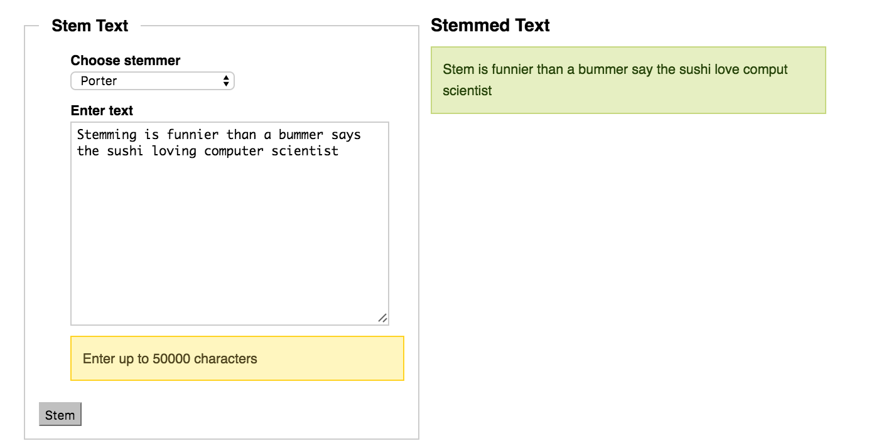
NLTK Stemming Demo
http://text-processing.com/demo/stem/

Slide 22
Stemming issues
How far should it go?
“denormalization” -> denormalize -> denormal -> normal -> norm?
How accurate can it be?
“bore”/ He wanted to bore a hole / He bore the students on his heart

Slide 23
How Useful is Stemming?
No consistent conclusion
Information retrieval
Search “dishwasher” to know how it works
Search “dishwashers” to shop around
Text categorization
Future tense vs. past tense in company performance report
“Will do” vs. “have done”

Slide 24
Convert Uppercase to Lowercase?
Emily Dickinson’s poem
“Joy” vs. “joy”
“Love” vs. “love”

Slide 25
Uppercase
But pompous Joy Betrays us, as his first Betrothal Betrays a Boy. | The Treason of an Accent Might vilify the Joy - To breathe - corrode the rapture Of Sanctity to be | Boundlessness - Expanse cannot be lost - Not Joy, but a Decree Is Deity - His Scene, Infinity -

Slide 26
Lowercase
Could she have guessed that it would be - Could but a Crier of the joy Have climbed the distant hill! - | I want to send you joy, I have half a mind to put up one of these dear little Robin’s, and . . . | I cant believe you are coming - but when I think of it, and tell myself it’s so, a wondrous joy comes over me, and my old fashioned life . . .

Slide 27
Remove Stop Words
Observation: words occur in most documents are not useful of distinguishing documents
Stopwords are usually function words that bear no specific meaning, compared to content words

Slide 28
Example of the start of a stop word list
a amongst becomes
about an becoming
across and been
after another before
afterwards any beforehand
again anyhow behind
against anyone being
all anything below
alone are besides
along around between
already as beyond
also be but
always because can

Slide 29
Little words can make big difference
Function words are useful for certain text mining tasks
genre classification
authorship attribution
gender detection
Notes:
Personal homepage identification using pronouns like “I” and “my”

Slide 30
Genre Classification
Personal Homepage Identification (Riloff, 1995)
Top features “I” and “my”
Riloff, E. (1995, July). Little words can make a big difference for text classification. In Proceedings of the 18th annual international ACM SIGIR conference on Research and development in information retrieval (pp. 130-136). ACM.

Slide 31
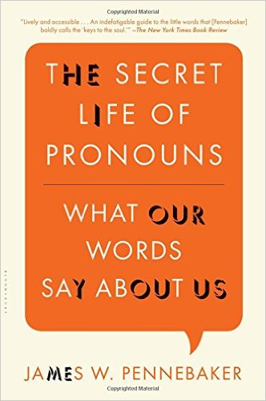
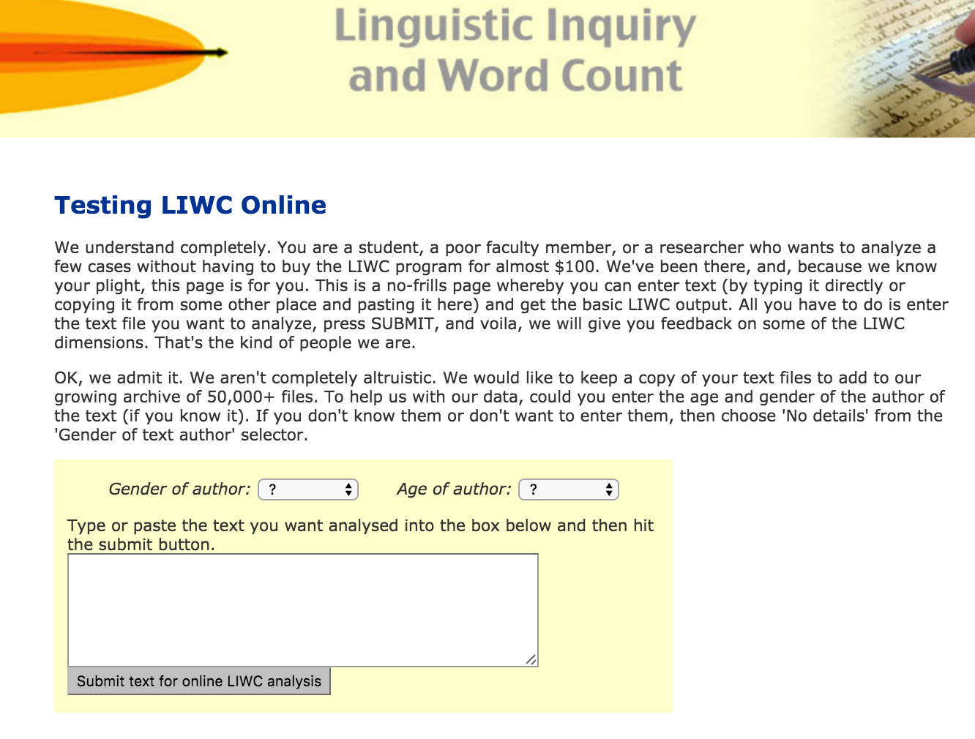
Personal Pronouns
LIWC

Slide 32
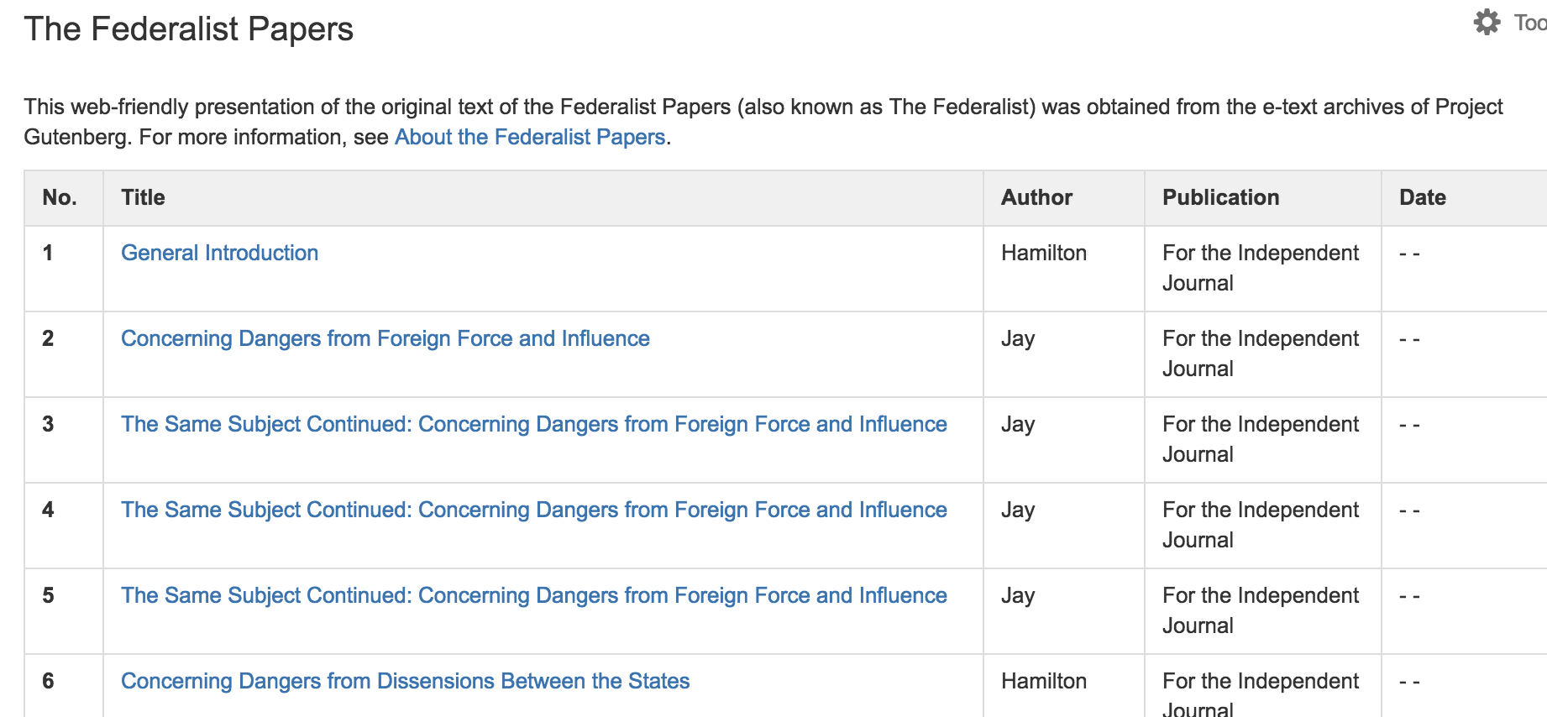
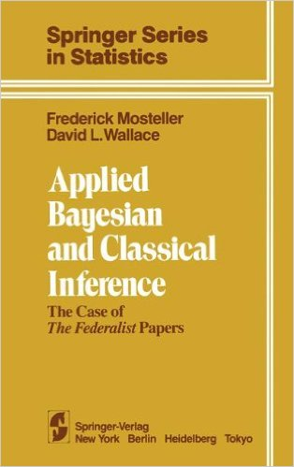
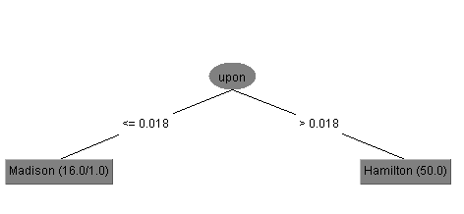
Function Words for Authorship Attribution
https://www.congress.gov/resources/display/content/The+Federalist+Papers
Notes:
The Federalist, commonly referred to as the Federalist Papers, is a series of 85 essays written by Alexander Hamilton, John Jay, and James Madison between October 1787 and May 1788. The essays were published anonymously, under the pen name "Publius," in various New York state newspapers of the time.

Slide 33
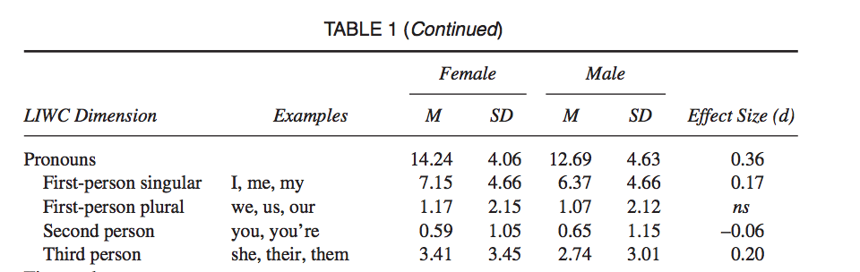
Gender Classification in General Texts
Newman, M. L., Groom, C. J., Handelman, L. D., & Pennebaker, J. W. (2008). Gender differences in language use: An analysis of 14,000 text samples. Discourse Processes, 45(3), 211-236.

Slide 34
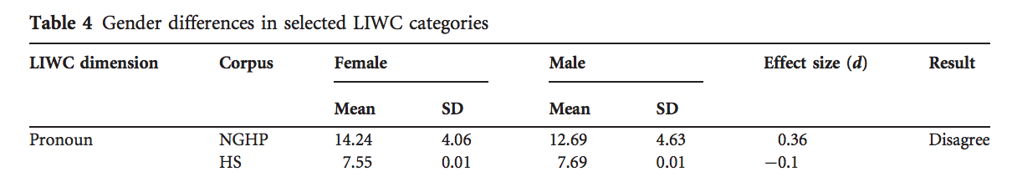
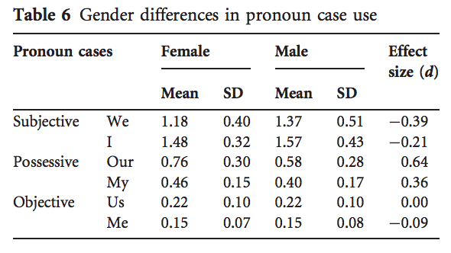
Gender Classification in Congress
CongressWomen | Congressmen
“our community” | “Our enemy”
“our workforce” | “Our side”
“We honor” | “We ought”
“We share” | “We gave”
Yu, B. (2014). Language and gender in Congressional speech. Literary and Linguistic Computing, 29(1), 118-132.

Slide 35
Exercise
Use Weka to apply stemming and stopword removal to movie review data

